Slide 1

Erasmus Student Network

Slide 2
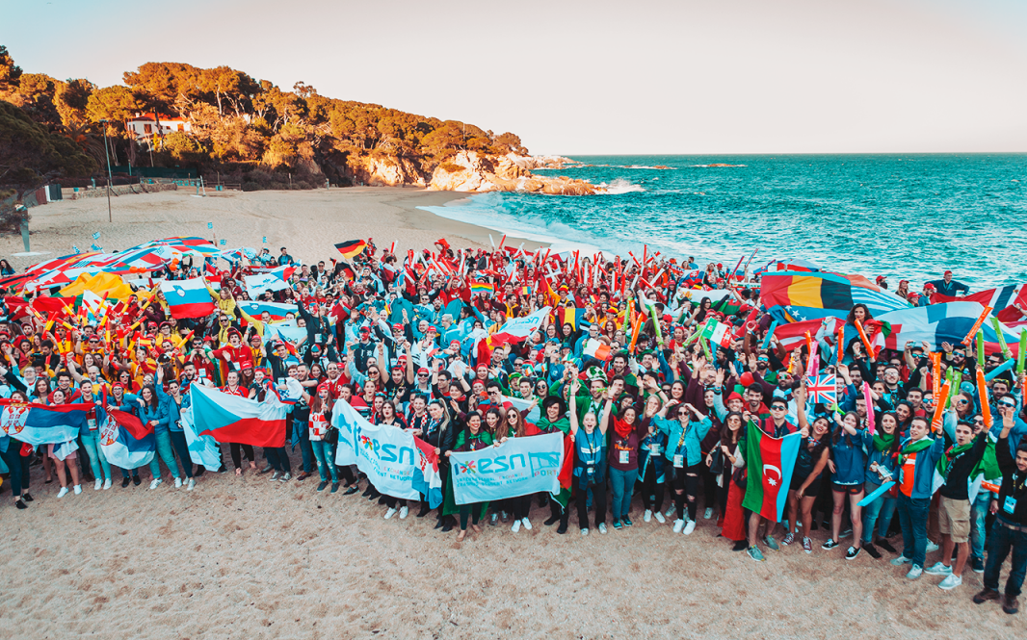

Slide 3
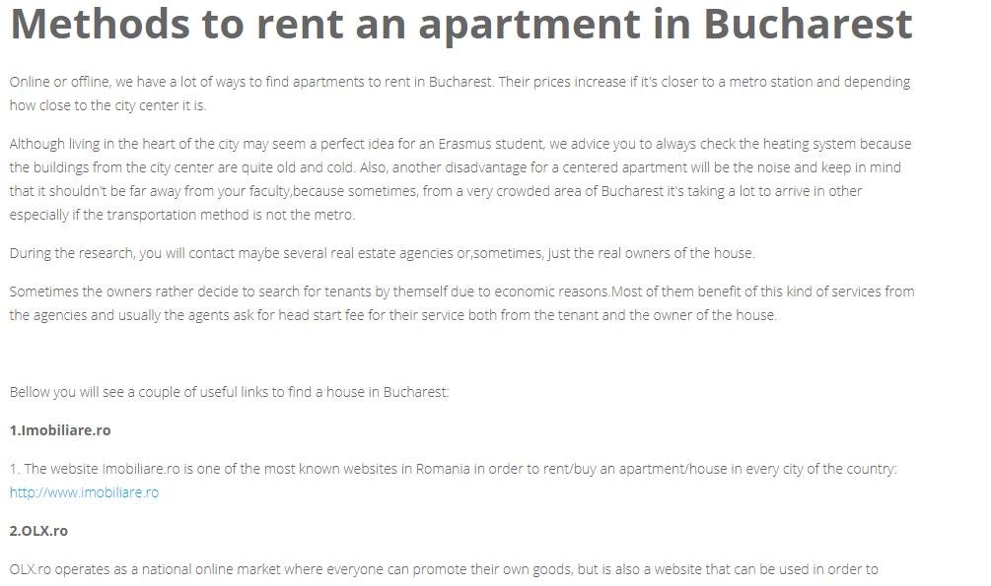

Slide 4


Slide 5
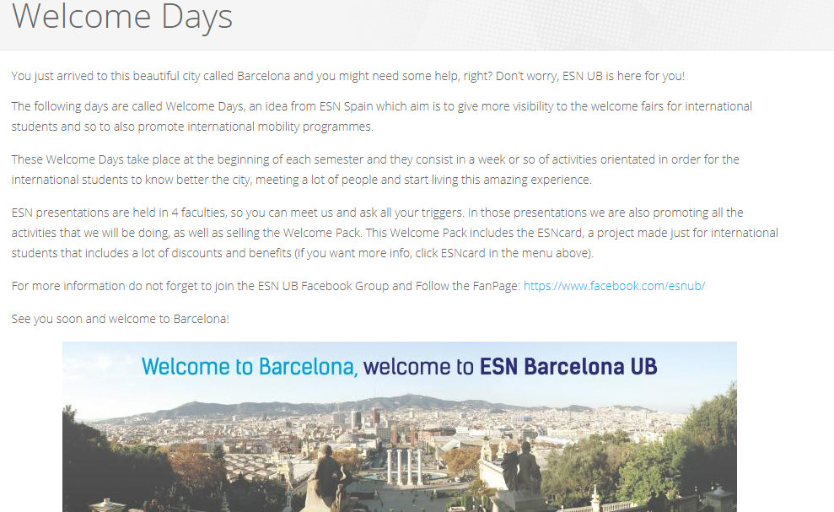

Slide 6
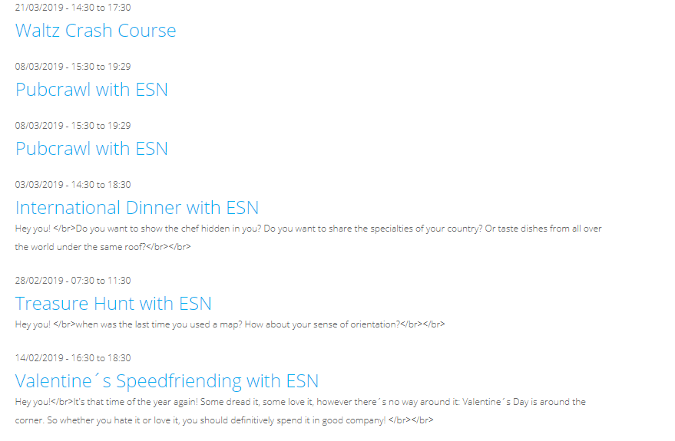

Slide 7
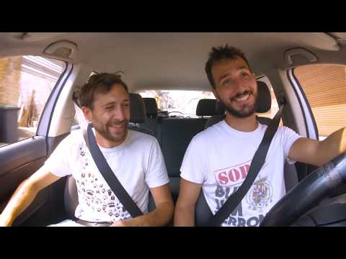

Slide 8
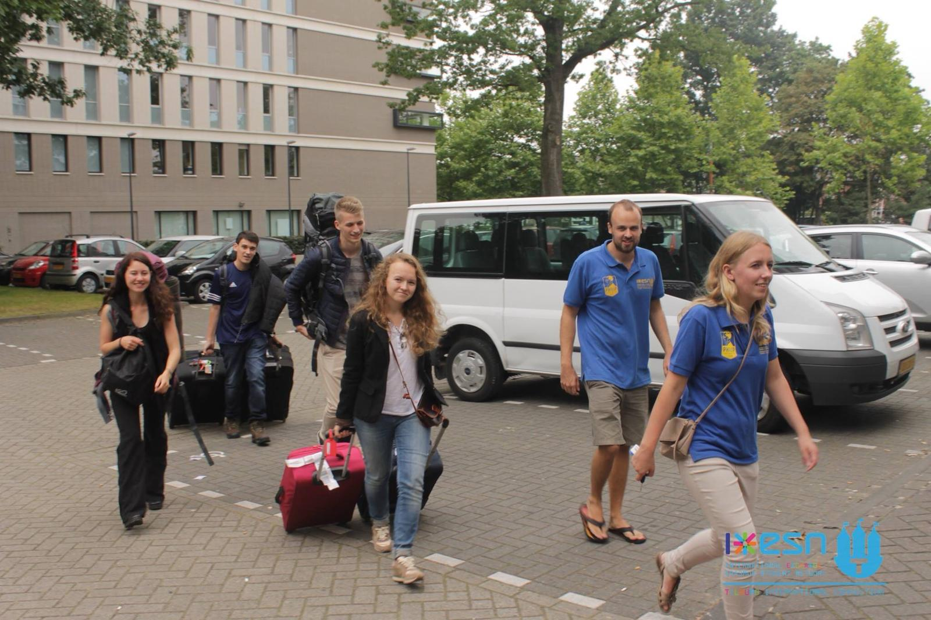

Slide 9
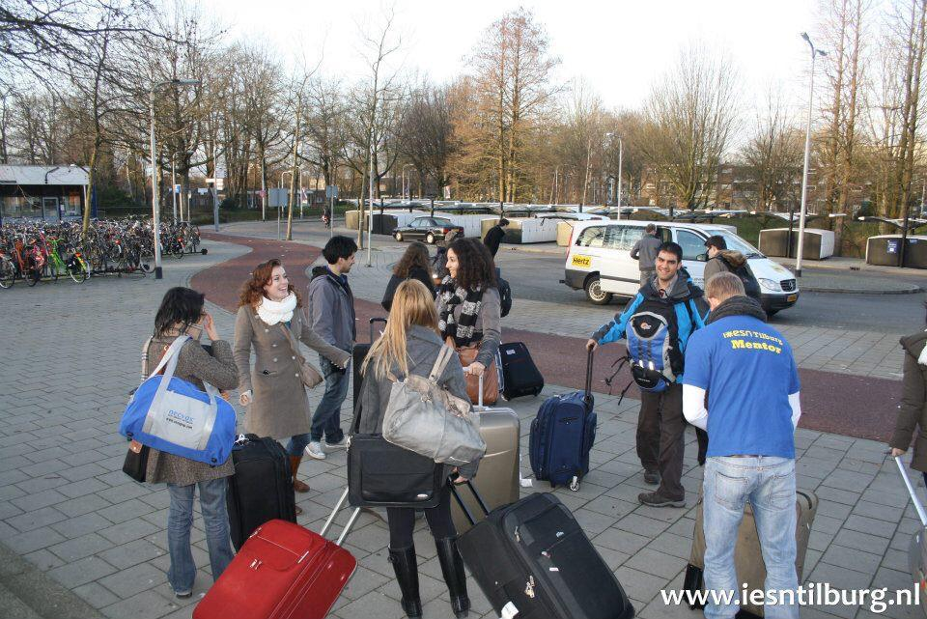

Slide 10
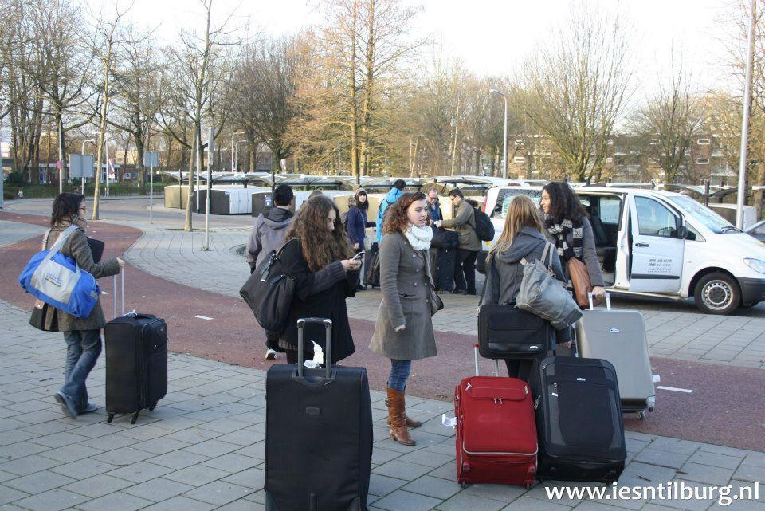

Slide 11
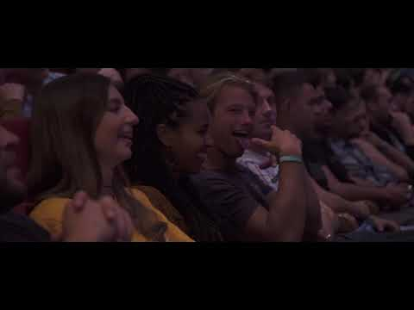

Slide 12
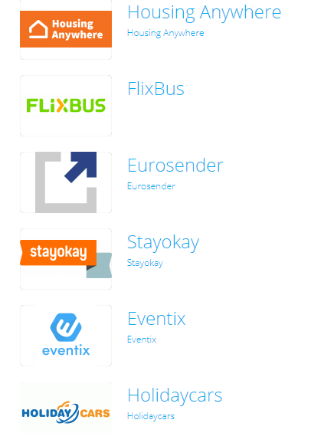


Slide 13


Slide 14
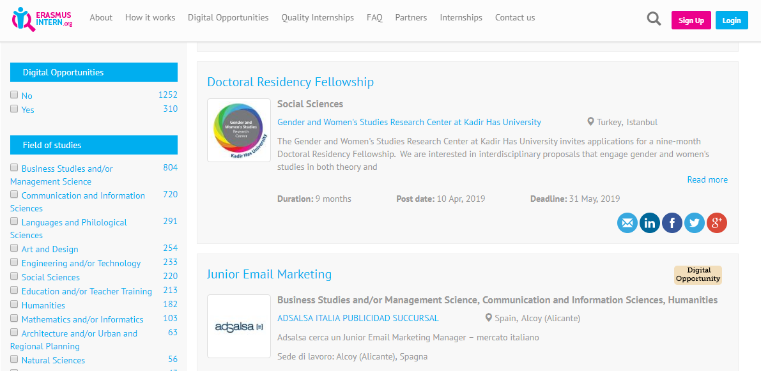

Slide 15
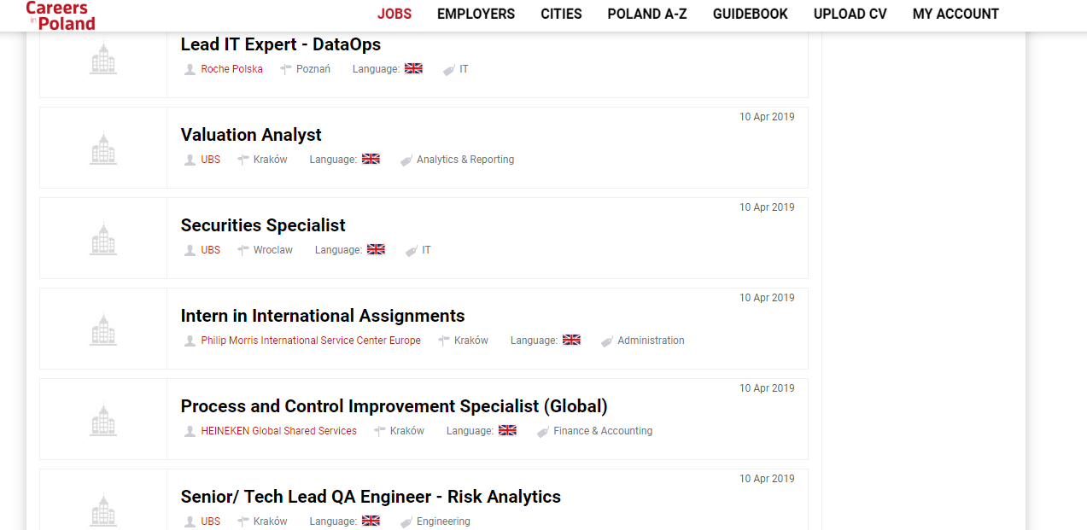

Slide 16


Slide 17

The causes of ESN

Slide 18
Social Inclusion

Slide 19
Erasmus in Schools

Slide 20
Social Inclusion Days
2x per jaar
19 nov - 3 dec 2018
29 apr - 12 mei - 2019
Focus: ‘The learning experience of the student during their volunteering activity and internationalisation at home for local students.’

Slide 21
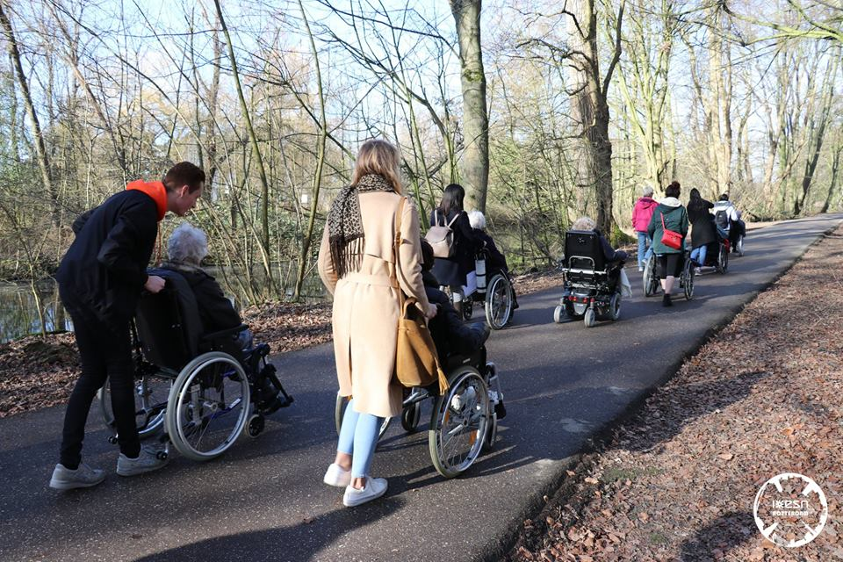

Slide 22
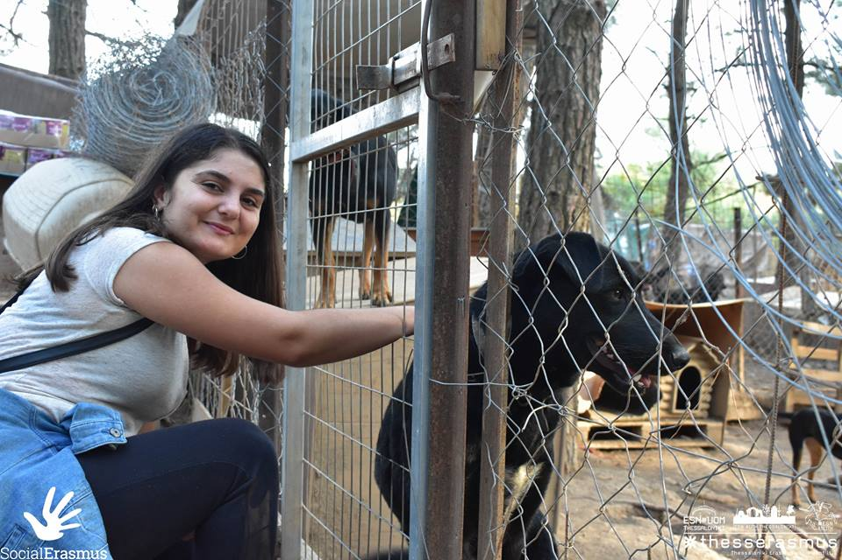

Slide 23
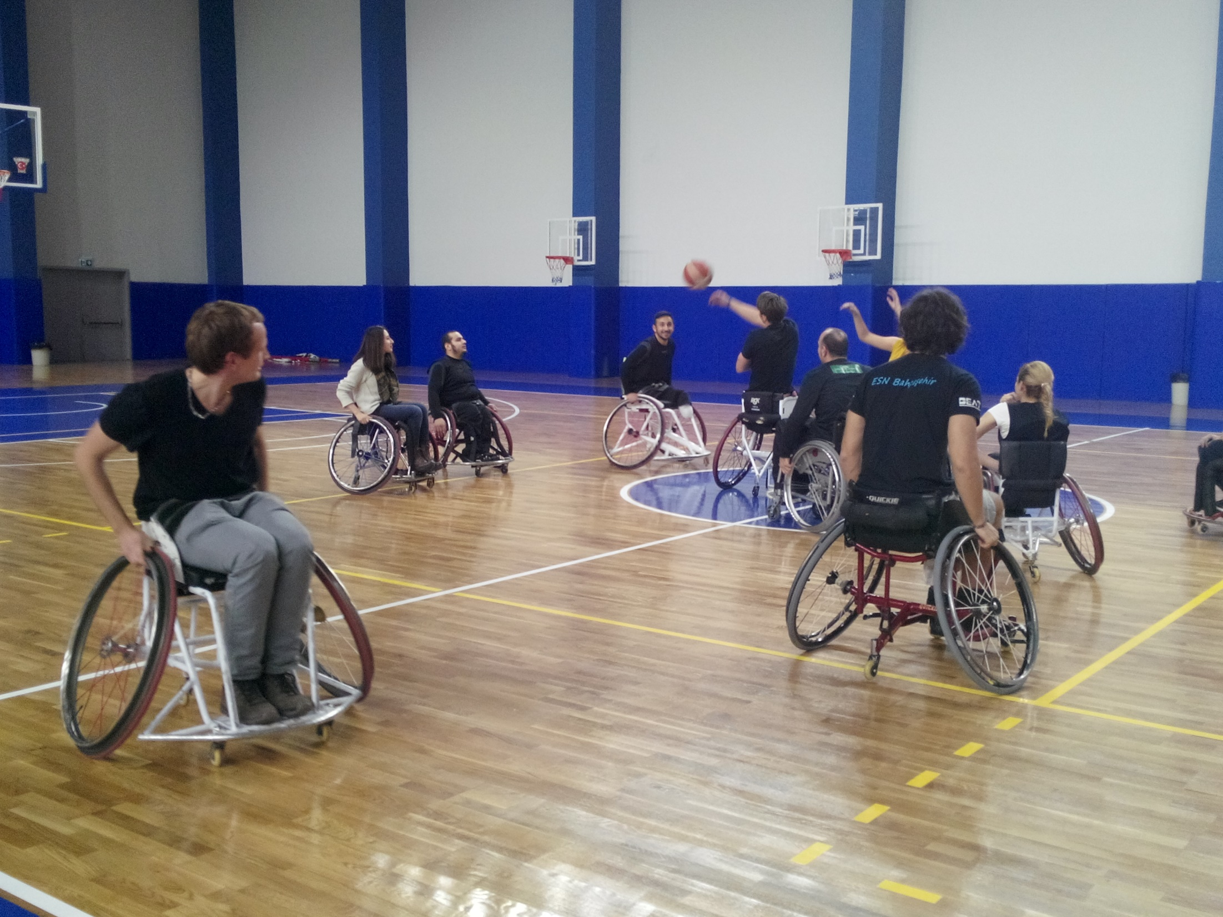

Slide 24
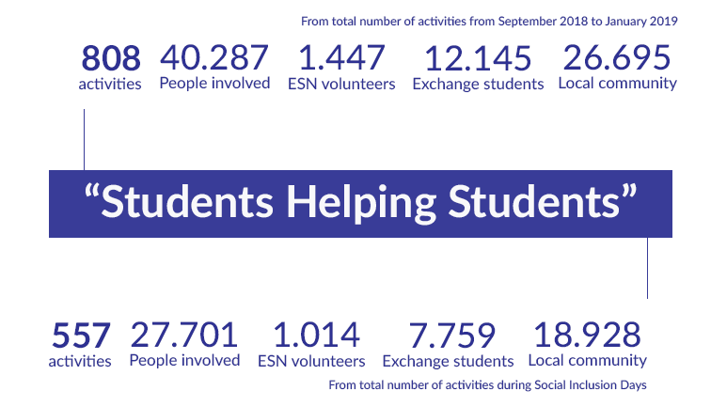

Slide 25

SocialErasmus Charter

Slide 26
Thank you
info@esn-nl.org

