Slide 1
Paul Leys – Ghent University
11 April 2019 – Amersfoort

Slide 2
Erasmus+ key process overview
inter-institutional agreements
application/
nomination
learning agreement
transcript of records

Slide 3
The paperless International Office (1)
Develop tools to get rid of paper
Less administrative workload = more time to focus on quality and support
Notes:
Reduce workload, not replace worklaod!

Slide 4
The paperless International Office (2)
Processes that we can manage ourselves:
Fact sheet data about the partner
Inter-institutional agreement
Exchange application
Learning agreement (student & outgoing exchange coordinator)
Grant agreement

Slide 5
The paperless International Office – limits (1)
Processes that we can manage ourselves:
Fact sheet data about the partner
Manual updates
Inter-institutional agreement
Signature from partner → PDF/paper
Exchange application
Nominations = email or nomination system
Learning agreement (student & sending coordinator)
Signature from receiving coordinator → PDF/paper

Slide 6
The paperless International Office – limits (2)
Processes that we can’t manage ourselves:
Confirmation of stay
Transcript of records

Slide 7
The missing link:

Slide 9
The network in practice

Slide 10
Inter-institutional agreements

Slide 11
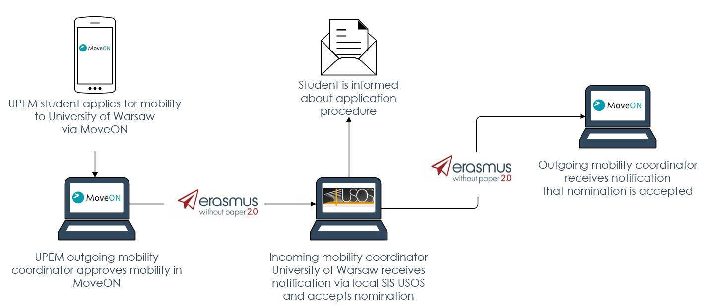
Nominations

Slide 12
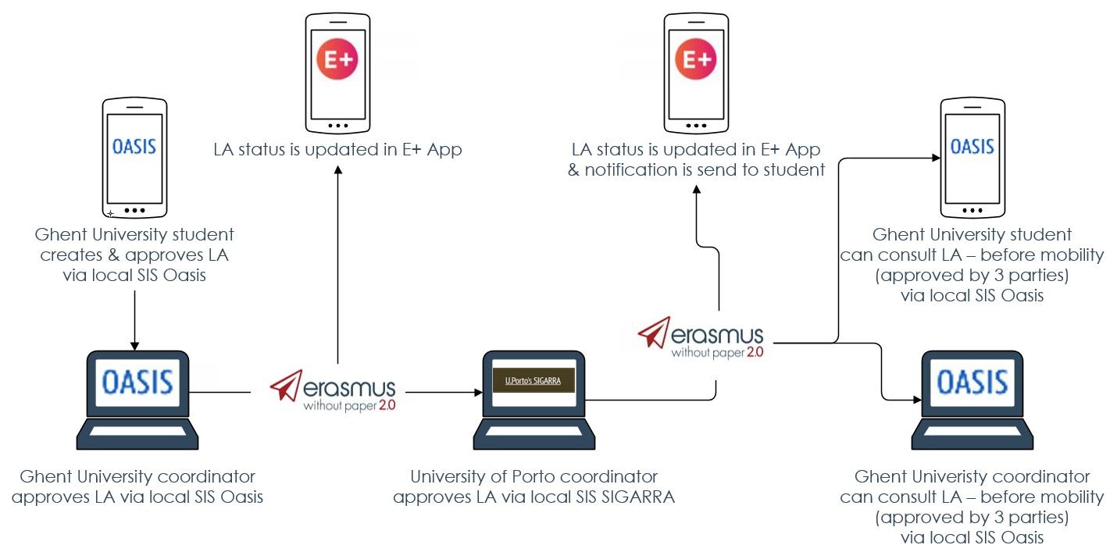
Learning Agreement

Slide 13
Confirmation of stay

Slide 14
Transcript of records

Slide 15
EWP in the next programme

Slide 19
How to join?

Slide 20
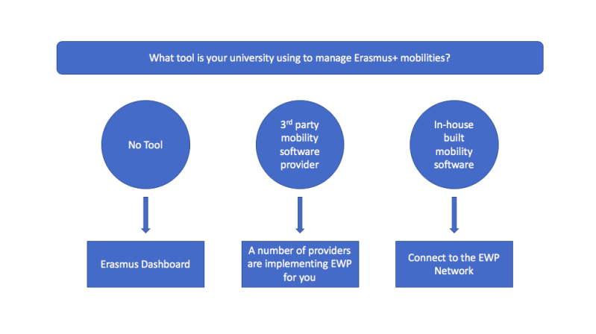

Slide 21
No specific IT-tools
Commercial SIS
SIS developed for consortium
SIS developed in-house

Slide 22
No university left behind

Slide 23
EWP network in practice
EWP “buffet of” APIs
Institutions (address, logo, contact persons)
Organisational units (faculties, departments, divisions)
Courses
Inter-institutional agreements / CNR (change notification receiver)
Outgoing motilities / CNR
Transcripts of records
Modular approach allows future extensions
Mobility tool connection

Slide 25
Partners

Slide 26
Stay informed
www.erasmuswithoutpaper.eu
@erasmuswp
ErasmusWithoutPaper

